Slide 1

Pie Chart
A pie-chart is a representation of values as slices of a circle with different colors
Syntax: pie(x, labels, radius, main, col, clockwise)
x - A vector containing the numeric values
labels - description to the slices.
radius - radius of the circle of the pie chart.(value between −1 and +1)
main - the title of the chart
col - the color palette.
clockwise - is a logical value indicating if the slices are drawn clockwise or anti clockwise.
1

Slide 2
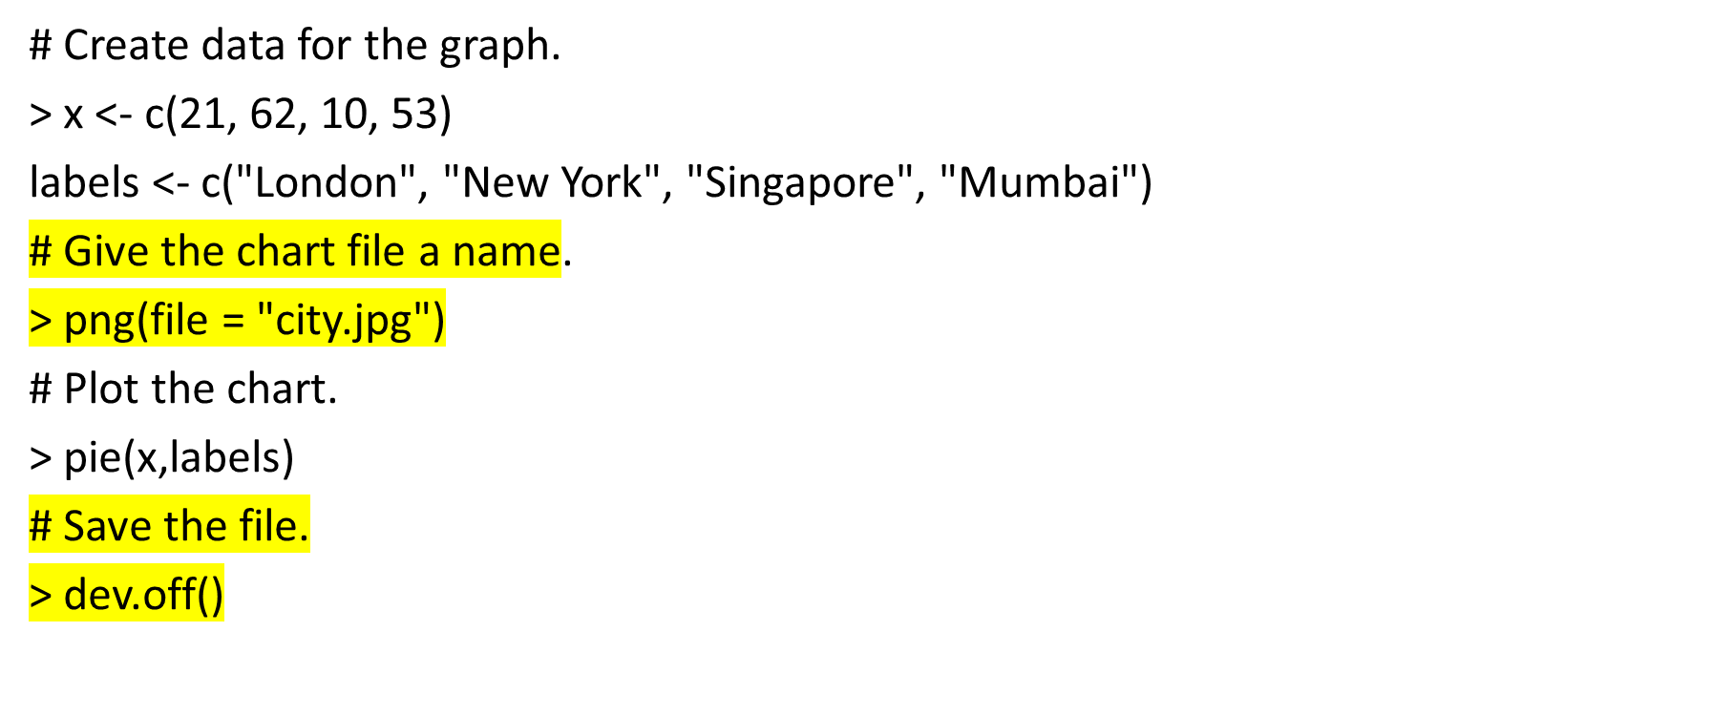
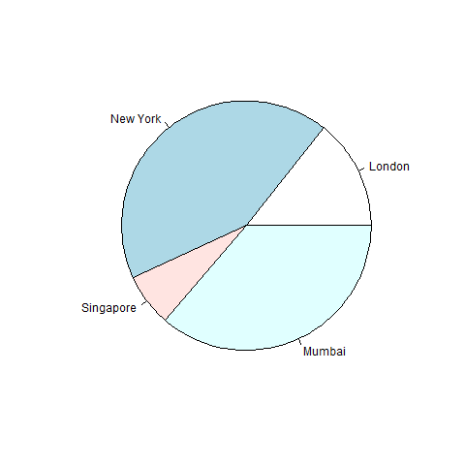
Pie Chart: Example

Slide 3
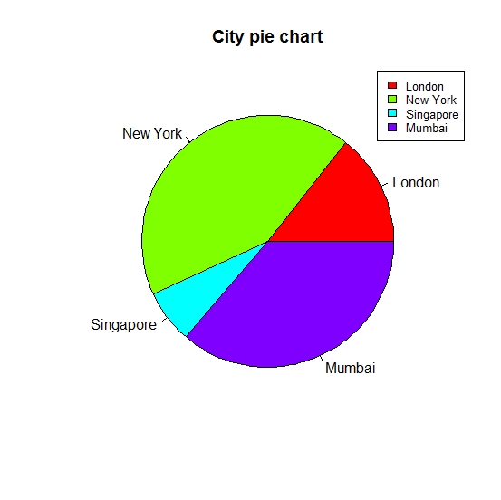
Pie Chart: Example (contd..)
pie(x, labels, main = "City pie chart", col = rainbow(length(x)))
pie(x, labels, main = "City pie chart", col = rainbow(length(x)),clockwise=TRUE)
# Adding Slice Percentage and Legends
> piepercent<- round(100*x/sum(x), 1)
> pie(x, labels=piepercent, main = "City pie chart", col = rainbow(length(x)))
> legend("topright", c("London","New York","Singapore","Mumbai"), cex = 0.8,
fill = rainbow(length(x)))

Slide 4
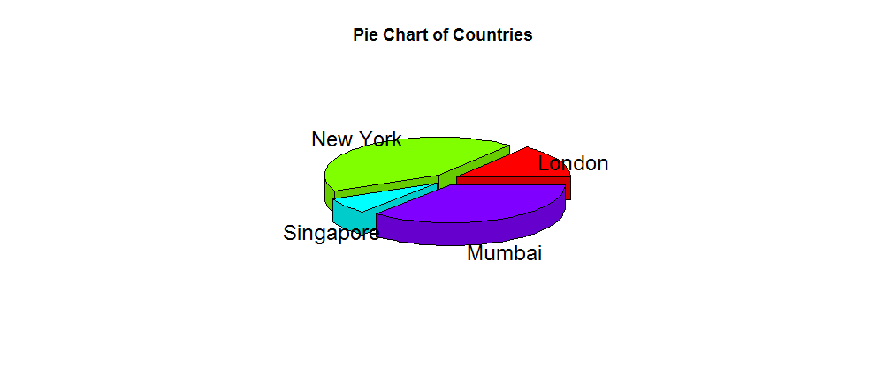
3D Pie Chart: Example
Install an additional Package “plotrix”
library(plotrix)
> x <- c(21, 62, 10,53)
> lbl <- c("London","New York","Singapore","Mumbai")
# Plot the chart.
> pie3D(x,labels = lbl,explode = 0.1, main = "Pie Chart of Countries ")

Slide 5
Pie Chart: Example 2 [who]
In the dataset “who.csv”, identify attributes that can be shown graphically using a pie chart
Plot Region variables as a pie chart so that each slice represents %age of the countries in that region.
Plot relative contribution of top 7 countries towards the global population. Add 8th slice as “Others” for the rest of the population.

Slide 6
Pie Chart: Example 3 [airquality]
In the dataset “airquality”, identify attributes that can be shown graphically using a pie chart

